Slide 2
What are the main barriers to learning in Maths and how can we help pupils to overcome them?
Julia Upton UP@king-ed.suffolk.sch.uk

Slide 3
The fear factor
Julia Upton UP@king-ed.suffolk.sch.uk
Notes:
Change the perception – acceptable to say can’t do maths
10 numeracy questions for them to do.

Slide 4
Q. 16 x 25

Slide 6
Solve:
2x - 5 = 14

Slide 7
3 4 5 8
Q. What is the mean?

Slide 8
Q. a² x a³ = a?

Slide 9
Q. Increase 60 by 20%

Slide 10
Q. 0.3 x 0.2

Slide 12
Q. -2 - - 5

Slide 13
Now calculate angle b
61°
b

Slide 14
Q. 16 x 25
Ans. 400

Slide 15
Ans. 18

Slide 16
Solve:
2x - 5 = 14
Ans. X = 9.5

Slide 17
3 4 5 8
Q. What is the mean?
Ans. 5
(Total =20 then divide by the number of values)

Slide 18
Q. a² x a³ = a?
Ans. a⁵

Slide 19
Q. Increase 60 by 20%
Ans. 72

Slide 20
Q. 0.3 x 0.2
Ans. 0.06

Slide 21
(If you got you could still divide top and bottom by 3)

Slide 22
Q. -2 - - 5
Ans. 3

Slide 23
Now calculate angle b
61°
b
Ans. 151°

Slide 24
Expectations
Julia Upton UP@king-ed.suffolk.sch.uk
Notes:
Setted subject, expectations too low, they are in set 5 so they won’t get a C grade
Foundation “banded” groups
Confidence the key issue

Slide 25
Changing the structure
Julia Upton UP@king-ed.suffolk.sch.uk
Notes:
Not to mess with staff having consistent groups and continuity and ownership for results
After Easter - revision carousel, each staff teaches a topic, let’s say 4 time to four different foundation groups – grew out of need (poor teacher, equality of examination preparation), time effective for teacher, resources good as preparation high, shared with other in team so collaborative, agreed key topics

Slide 26
Intervention
Julia Upton UP@king-ed.suffolk.sch.uk
Notes:
Easter revision sessions for targeted students – maths staff paid or day off in lieu
Sixth form mentors, HLTA, extra staff member – support outside the classroom, been in a class of 30 for 5 years and still doesn’t get it, needs smaller group, opportunity to ask more detail and time
Sixth form students – those doing AS maths and those who got C grades
Don’t look to always get lower class sizes, 6 sets and 1 member of staff for withdrawal allow you to target students, the argument that the smaller the group the better the attainment doesn’t wash from 30 to 26. But from 30 to group of 5 it does.

Slide 27
Recommended resources
Julia Upton UP@king-ed.suffolk.sch.uk
Notes:
Maths Watch CD
Mymaths.co.uk

Slide 28
Recommended Resources
www.mymaths.co.uk
MathsWatch CD
www.kangaroomaths.com
MEP – resources Exeter University
Notes:
Kangaroo – assessment, make the grade

Slide 29
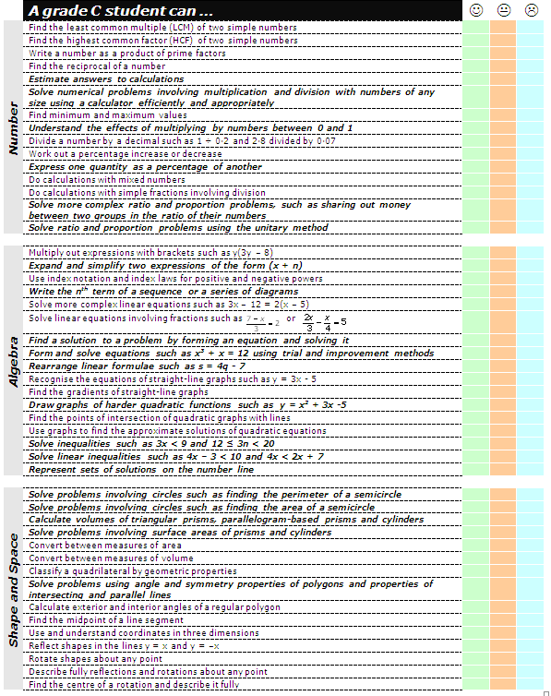
Notes:
Kangaroo maths – make the grade

Slide 30
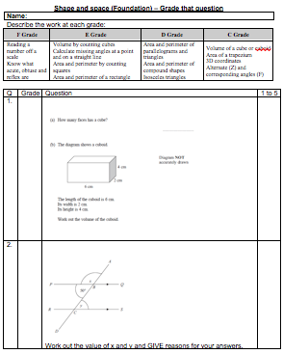
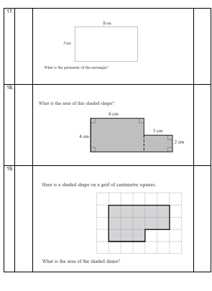
Notes:
Kangaroo maths – make the grade

Slide 31
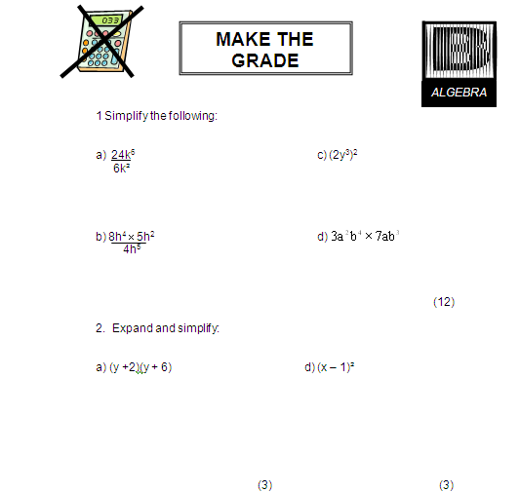
Notes:
Kangaroo maths – make the grade

Slide 32
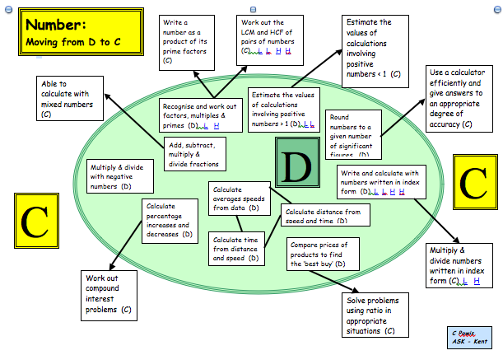
Notes:
Moving from one grade to another at GCSE – helps the students to structure their development – reality of 80% G-D questions but allows them to see the building blocks

Slide 33
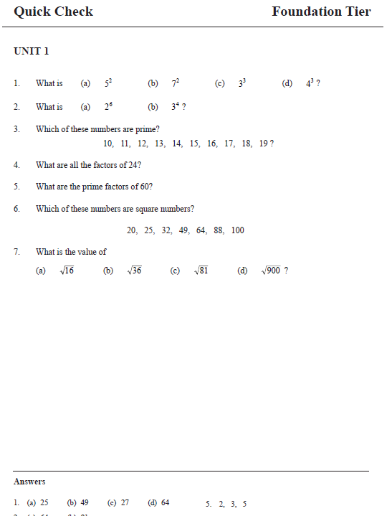
Notes:
Mep topic check

Slide 34
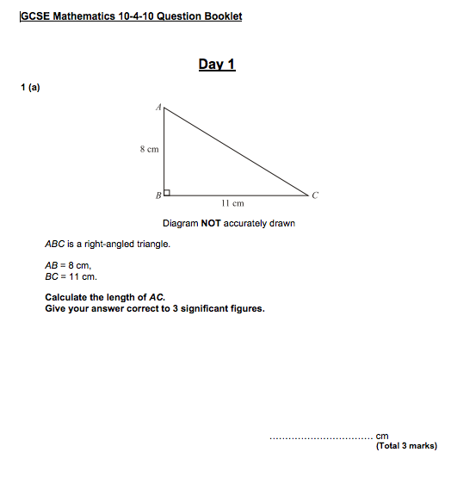
Notes:
10 for 10 questions

Slide 35
Diagnostic questions
Julia Upton UP@king-ed.suffolk.sch.uk

Slide 36
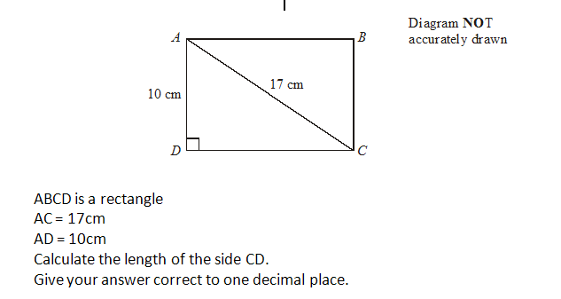

Slide 38
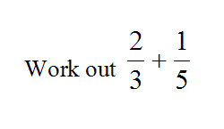
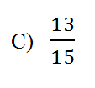
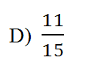

Slide 39
Skills reminders
Julia Upton UP@king-ed.suffolk.sch.uk

Slide 40
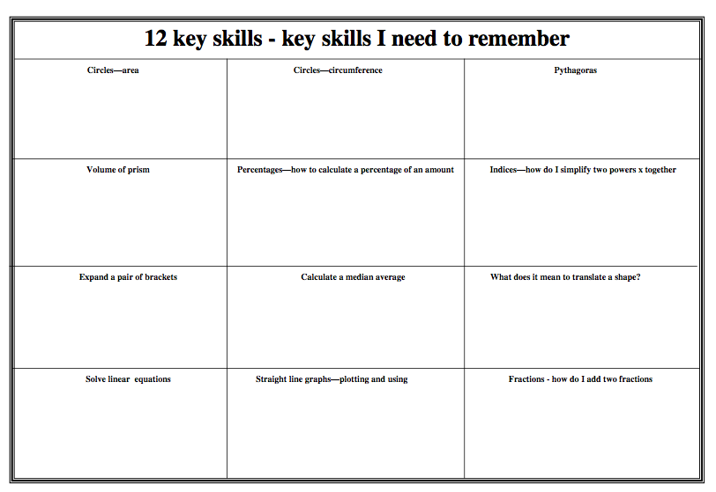
Notes:
Not just the bare facts but HOW to use them

Slide 41
Proportionality
Julia Upton UP@king-ed.suffolk.sch.uk
Notes:
240 students in a survey – what do they drink, 60 drunk coffee, what angle is this on a pie chart? What percentage is this?
100mph, how far do I go in 3 hours? What time will it take me to go 70 miles?

Slide 42
Proportionality
240 students in a survey
Asked what do they drink most often at break
30 said coffee
What angle is this on a pie chart?
What percentage is this?
Notes:
30/240 x 360 = 45 degrees
30/240 x 100 = 12.5%

Slide 43
Proportionality
A car is travelling at 100mph
How far do I go in 3 hours?
What time will it take me to go 70 miles?
If I halved my speed to 50mph how long would it take me?
Notes:
300 miles
0.7 x 60 minutes = 42 minutes

Slide 44
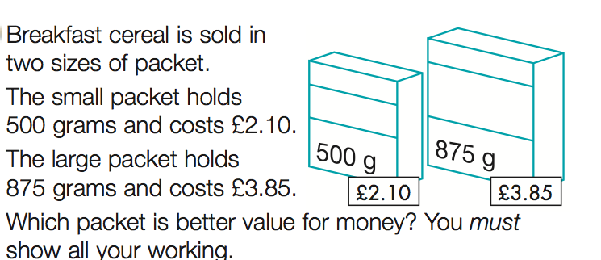
Proportionality
Notes:
2.1/500 = 0.0042 pence per gram
3.85/875 = 0.0044

Slide 45
Proportionality
5 miles : 8 kilometers
Notes:
5 miles = 8 km
120/8 = 25 x 5 = 75 miles per hour

Slide 46
D to C skills v A to A* skills
Julia Upton UP@king-ed.suffolk.sch.uk

Slide 47
C Grade in Mathematics
Skills and formulae to learn
Confidence
Commit pen to paper
Proportionality
Notes:
The boys issue!

Slide 48
A* Grade in Mathematics
Skills and formulae to learn
Confidence
Adaptablity
Transferability
Algebraic manipulation

Slide 49
What are the main barriers to learning in Maths and how can we help pupils to overcome them?
Julia Upton UP@king-ed.suffolk.sch.uk

Slide 50
Key Messages
Work with individuals and genuinely unpick their misconceptions
Don’t just focus on the “C” grade skills – their misunderstandings are often at a more fundamental level – 80% of the questions on the exam are below C grade
Get students confident to “have a go” – the number-phobic but hardworking students often don’t put pen to paper for fear of it being wrong

Slide 51
What are the main barriers to learning in Maths and how can we help pupils to overcome them?
Julia Upton UP@king-ed.suffolk.sch.uk

